Slide 1


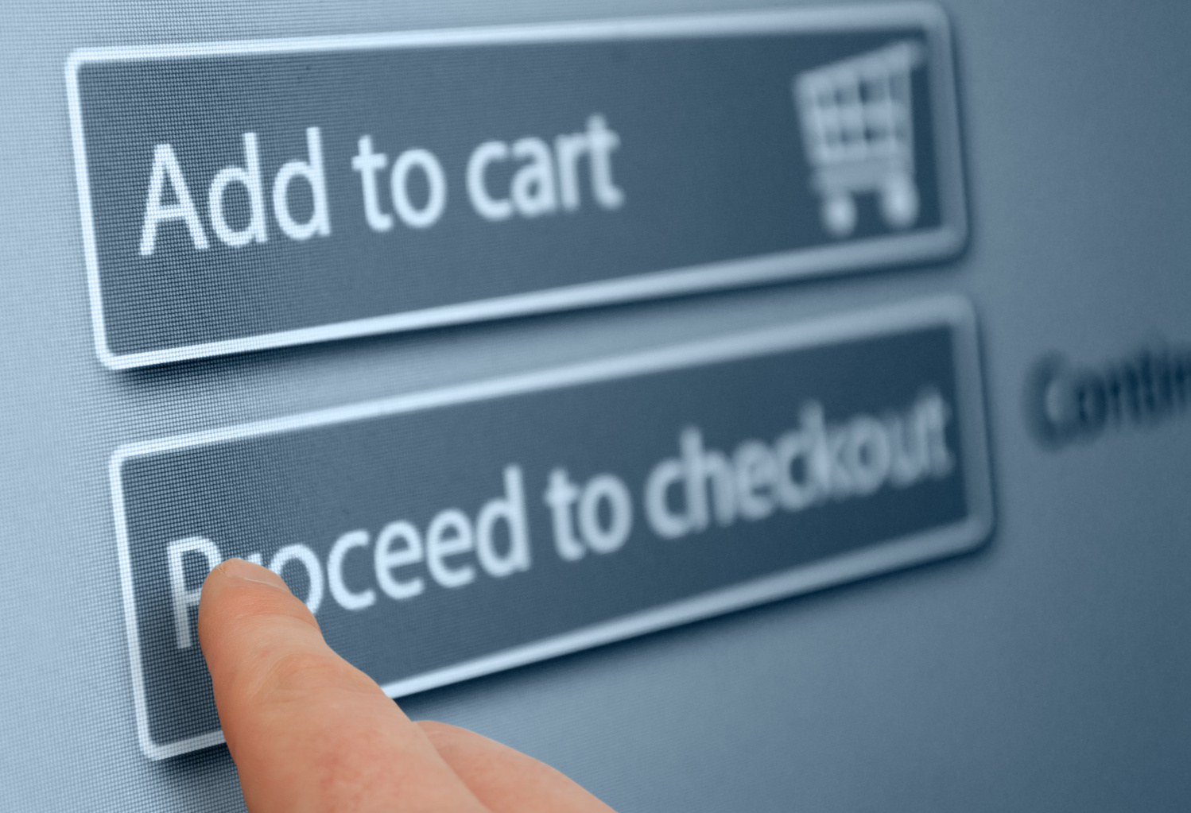

Marketing Dataset Project
ENT 2017: AI and Data Analytics
Group 8: LaldinPuia Hmar, Isha, Kushal Shahi, Shruti, Adarsh Tiwari

Slide 2

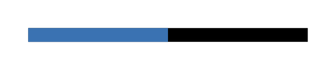
Introduction
Purpose: This project analyzes a marketing dataset with customer-level data using various AI and data analytics techniques. The goal is to identify patterns, predict behaviors, and provide actionable insights for improved marketing strategies.

Slide 3
Data Overview

Slide 4
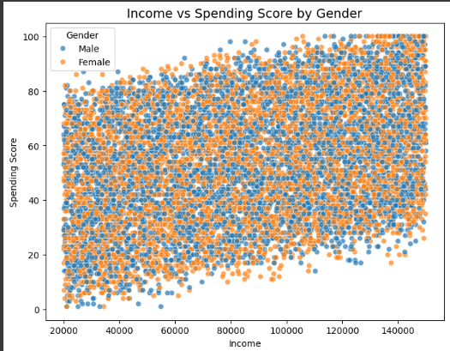
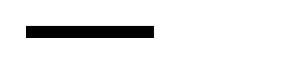
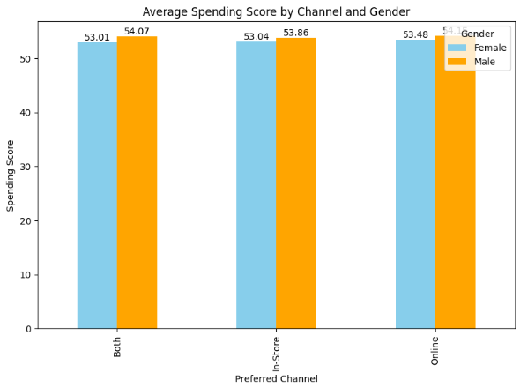
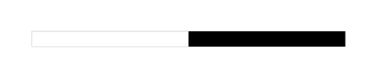
Dataset:
Information on 10,000 customers
Includes their Age (18–70 years), Gender, Income, SpendingScore (1–100), PreferredChannel of shopping (Online, In-Store, Both), etc.
Preliminary Observations:
There’s a clear positive correlation b/w income and spending score
Spending Score vs Gender: Males tend to spend slightly more than females

Slide 5
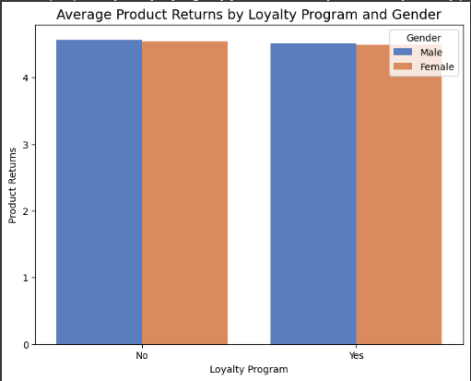
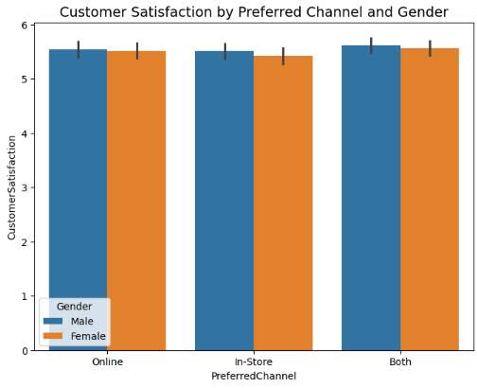
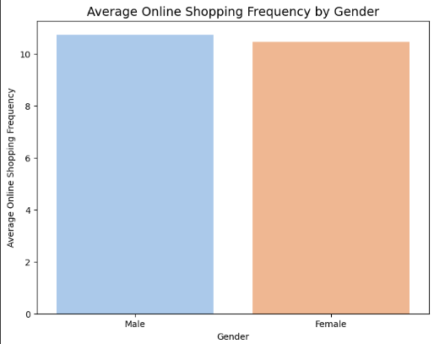
Preliminary Observations on the dataset:
Online shopping freq vs Gender
Customer Satisfaction vs Gender
Product Returns vs Gender
The above 3 graphs show males tend to shop more through every channel, have greater satisfaction with products and average product returns are higher than females.

Slide 6
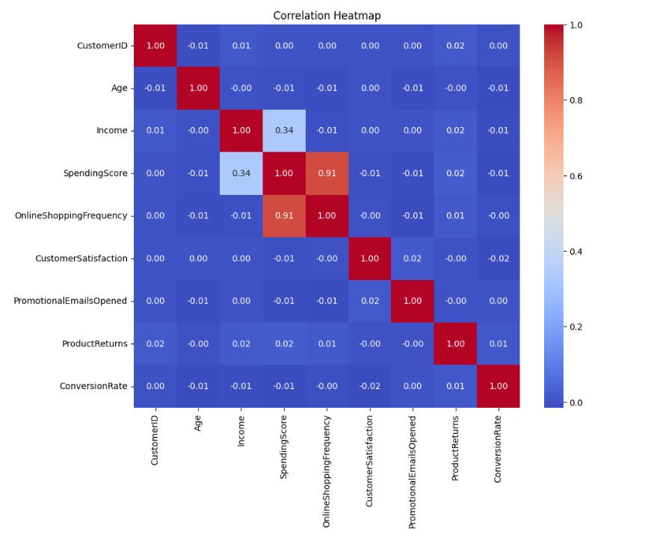
CORRELATION HEATMAP
We observe high correlation between customer income and spending score
We observe a very high correlation between spending score and Online shopping frequency of customers
Very low to negligible correlation between all the other features

Slide 7
Data Modelling
Data Preprocessing and Feature engineering
KMeans Clustering
ANOVA
Regression Analysis
KNN
Naive Bayes
CART
Logistic Regression

Slide 8

Data Preprocessing
Checked for distribution of the data using histogram-- no skewness found
We checked for null values -- No null values in the data
There are no duplicate values in the data
Checked for outliers using IQR and Box plots
Checked for balance and imbalance in the target variable-- its balanced!
Feature Engineering
We used LabelEncoder and OneHotencoder to transform categorical variables into binary values
Used minmax scaler to normalize the features in the train and test data

Slide 9

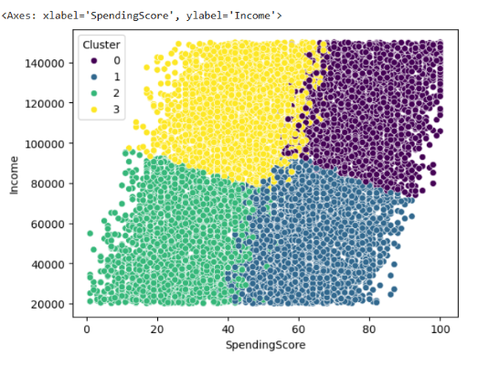
KMeans Clustering
Cluster wise customer segment analysis – SpendingScore & Income
Cluster 0: High-income & high-spending score: Target luxury or high-priced items for this group
Cluster 1: Low-income & high-spending score: Focus on affordable, value-oriented marketing
Cluster 2: Low-income & low-spending score: Costly to target due to minimal purchasing behavior and potential to purchase
Cluster 3: High-income & low-spending score: Opportunity to influence spending behavior for increased sales

Slide 10
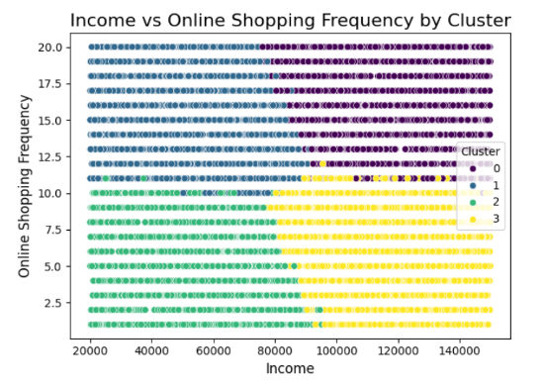
KMeans Clustering
Cluster wise customer segment Analysis – Income & Online Shopping frequency
Cluster 0: High-income & high online shopping frequency: Target with premium online shopping campaigns.
Cluster 1: Low-income & high online shopping frequency: promote value-oriented online purchase
Cluster 2: Low-income & low online shopping frequency: Limited potential for targeted marketing efforts.
Cluster 3: High-income & low online shopping frequency: Focus on increasing their online purchases through premium products

Slide 11
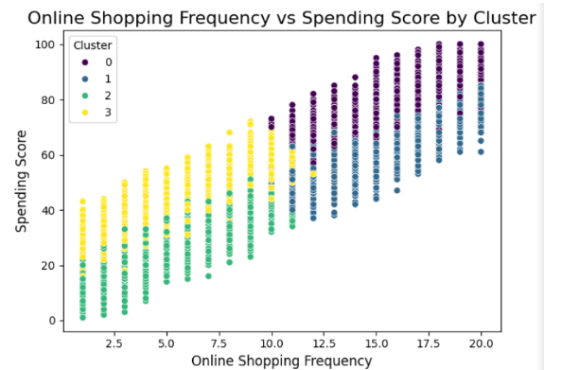
KMeans Clustering
Cluster wise customer segment Analysis – Online Shopping Frequency & Spending Score
Cluster 0: High online shopping frequency & High spending score
Cluster 1: High online shopping frequency, moderate spending score
Cluster 2: Low online shopping frequency & lowest spending score
Cluster 3: Low shopping frequency & moderate spending score
Cluster wise customer segmentation & Marketing Recommendations
Cluster 0: High-spending score, high-income, frequent online shoppers → Luxury & high-price goods
Cluster 1: High (moderate)-spending score, low-income, High online shopping → Affordable items, frequent promotions.
Cluster 2: Low-spending score, low-income, low online shopping → Avoid marketing focus.
Cluster 3: High-income, low-spending score, low online shopping → Campaigns to shape spending behavior, especially online

Slide 12
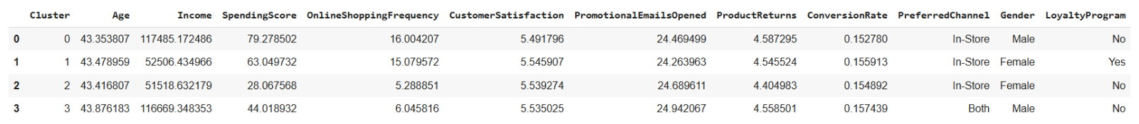
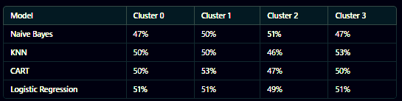
KMeans Clustering
Cluster overview (Average values and Max frequencies)
Cluster wise highest accuracies:
Cluster 0: Logistic Regression has highest accuracy
Cluster 1: CART delivers the highest accuracy.
Cluster 2: Naive Bayes is most effective.
Cluster 3: KNN provides the best classification accuracy.

Slide 13
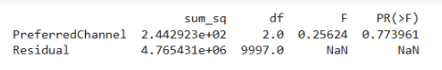

ANOVA Analysis
Determine if average spending scores differ across shopping channels (Online, In-Store, Both) for the dataset
Findings
At the 5% significance level, the average spending scores are equal across all shopping channels.
Shopping channel preference does not significantly influence customer spending behavior.
Marketing Implications & Strategies
Uniform Spending Behavior Across Channels: Focus on broad, cross-channel marketing campaigns instead of channel-specific promotions.
Cross-Channel Opportunities: Promote omnichannel experiences. Ex: Shop online, pick up in-store. Provide consistent promotions across all channels.
Customer-Centric Segmentation: Shift focus to customer-centric promotions such as income, spending score, or product preferences.
Channel Investment Decisions: Evaluate operational costs of each channel & Reallocate resources to improve efficiency or customer experience uniformly.
Experimentation Potential: Experiment with promotions targeting specific customer segments in each channel. Measure the impact of discounts, loyalty rewards, or new offers.

Slide 14
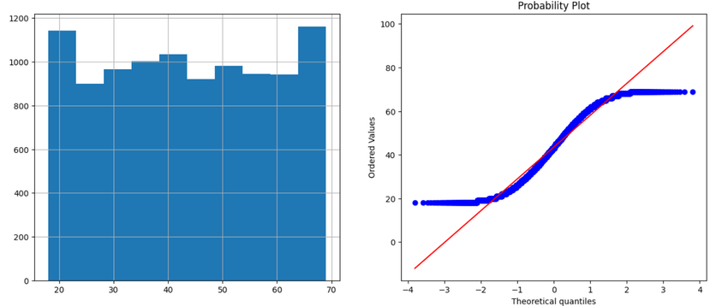
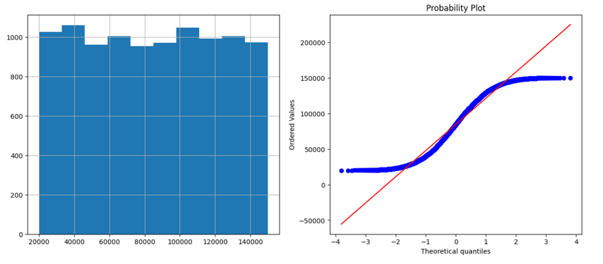
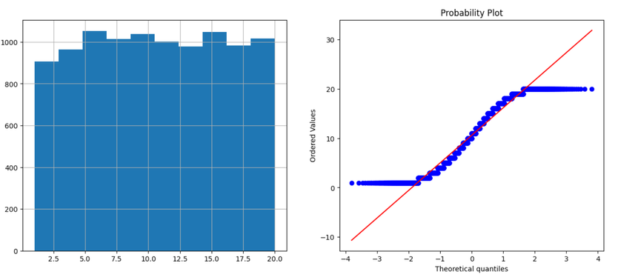
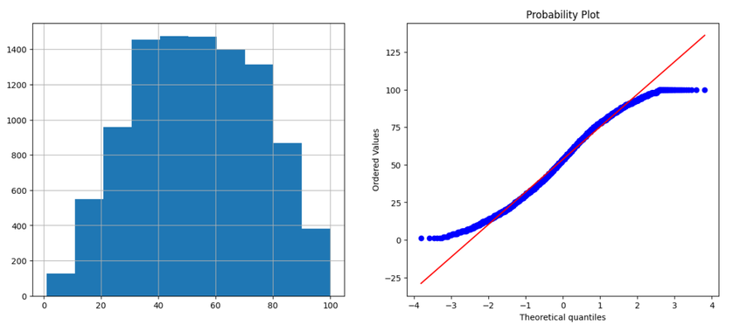

Regression Analysis
Assumptions & Methodology
Linearity: Pairwise scatter plots indicate mostly linear relationships (except Age vs. Spending Score)
Normality: QQ plots confirm approximate normality for features and residuals (5% significance level)
Homogeneity of Variances: Levene's Test confirms equality of variances among features
Mean Equality: Two-tailed t-tests show no statistical differences between mean values across features
AGE
Income
Online Shopping Frequency
Spending Score

Slide 15
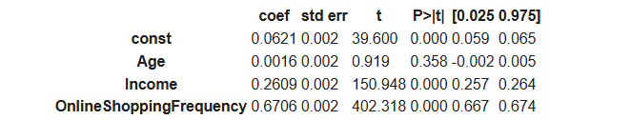
Regression Analysis
Coefficient Interpretation
Income (0.2609): Every 1-unit increase in income raises Spending Score by 0.2609 points (statistically significant).
Online Shopping Frequency (0.6706): Every 1-unit increase in shopping frequency raises Spending Score by 0.6706 points (statistically significant).
Age (0.0016): A 1-year increase in age raises Spending Score by 0.0016 points (not statistically significant).

Slide 16
Regression Analysis
Model Performance
Mean Squared Error (MSE) is 0.25 : This indicates that, on average, the squared difference between the actual Spending Scores and the predicted values is minimal, signifying high predictive accuracy.
R-squared (R²): The model explains 94.8% of the variance in Spending Score using the predictors (Age, Income, and Online Shopping Frequency). This high R² value shows that the model fits the data well, leaving only 5.2% of the variance unexplained, potentially due to factors not included in the model.
Insights & Implications
Income & Online Shopping Frequency: Significant predictors of Spending Score. Focus marketing efforts on high-income and frequent online shoppers for better returns.
Age Factor: Age has minimal influence; prioritize other predictors for segmentation.
High Model Accuracy: Confirms strong predictive capabilities for Spending Score using selected variables.

Slide 17
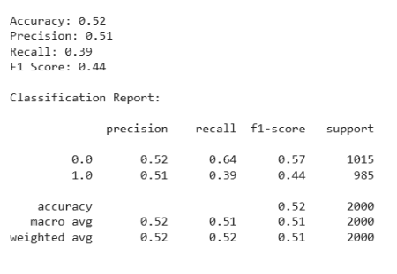
K-Nearest Neighbors (KNN) Analysis
Classify customer loyalty program membership (Yes/No) using demographic and behavioral variables.
Optimization Process
K Value Selection:
Explored k values in the range of 1 to 10.
Optimal k=8, with a threshold of 0.5, provided the maximum model accuracy.

Slide 18
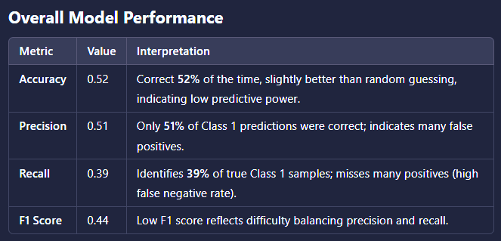

Slide 19
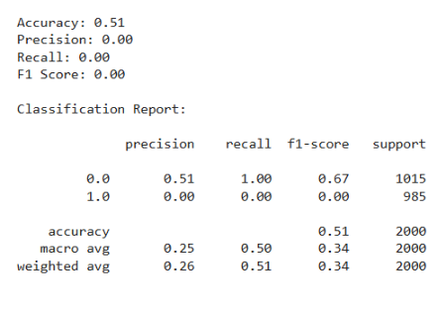
Naive Bayes Analysis
Classify loyalty program membership (Yes/No) using predictors such as Age, Income, Spending Score, and Online Shopping Frequency.
1. Overall Accuracy:
The model is correct in 51% of predictions.
However, accuracy alone is not meaningful as the model appears heavily biased toward Class 0.0.
2. Class 1.0 (Loyalty Program Members):
Precision: 0.00 – None of the predicted Class 1.0 instances are correct.
Recall: 0.00 – The model fails to identify any true instances of Class 1.0.
F1-Score: 0.00 – Indicates a complete failure to balance precision and recall for Class 1.0.

Slide 20

Naive Bayes Analysis
3. Class 0.0 (Non-Members):
Precision: 0.51 – About half of the predictions for Class 0.0 are correct.
Recall: 1.00 – Captures all actual Class 0.0 instances (perfect recall).
F1-Score: 0.67 – Higher than Class 1.0 due to perfect recall, despite limited precision.
4. Class Imbalance Handling:
For class 0.0:
Precision (0.51): About half of the predictions for class 0.0 are correct.
Recall (1.00): The model predicts every instance as 0.0, so it captures all actual 0.0 labels perfectly.
F1-Score (0.67): Higher than class 1.0 because the model completely neglects class 1.0.

Slide 21
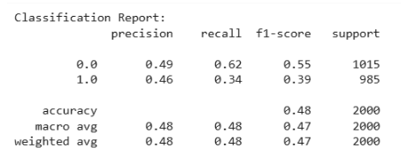
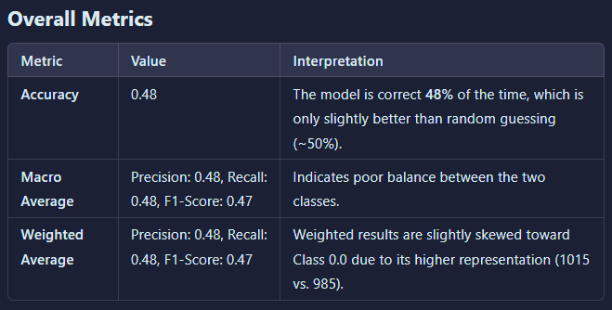
Logistic Regression Analysis
Predict loyalty program membership (Yes/No) using variables such as Age, Income, Spending Score, and Online Shopping Frequency.

Slide 22
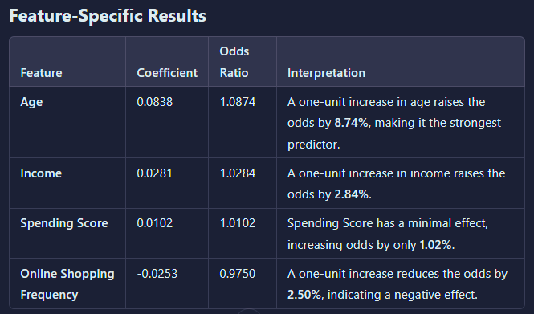
Logistic Regression Analysis

Slide 23
Logistic Regression Analysis
Insights from the Visualization
Online Shopping Frequency: Negatively affects the likelihood of loyalty program membership (Odds Ratio<1).
Age, Income, and Spending Score: Positively affect membership, with Age having the most significant impact.
General Observations
Age as the Strongest Predictor: A one-unit increase in age raises the odds by 8.74%, indicating its substantial influence on program membership.
Minimal Impact of Spending Score and Income: While both have a positive effect, their contributions to the odds are small.
Negative Effect of Online Shopping Frequency: This surprising result suggests that customers with high online shopping frequency are slightly less likely to join the loyalty program.

Slide 24

Final Recommendations
Customer-Centric Marketing:
Cluster 0: Target high-income, high-spending customers with premium, luxury products.
Cluster 1: Use frequent promotions for affordable items to attract low-income, high online shoppers.
Cluster 3: Encourage spending through personalized campaigns for high-income, low-spending customers.
2. Optimize Omnichannel Experience:
Promote "shop online, pick up in-store" campaigns.
Ensure consistent promotions across all channels to drive engagement.
3. Focus on High-Impact Predictors:
Prioritize marketing to high-income and frequent online shoppers for maximum ROI.
Deprioritize age and low-spending customers for resource efficiency.
4. Experiment & Adapt:
Test loyalty rewards and targeted promotions to improve retention.
Address barriers to loyalty program adoption for frequent online shoppers.

Slide 25

LIMITATIONS
Low Model Accuracy: The model does not perform well in predicting Loyalty Program membership.
Hyperparameter Tuning: Despite using GridSearchCV and experimenting with thresholds and parameters, results remain suboptimal.
Data Quality Concerns: Even after extensive preprocessing, the model's performance is limited, possibly due to issues with data quality.
Balanced Target Variable: The balanced nature of the target variable might be affecting predictive performance.
Future Suggestion: Acquire more detailed and high-quality data to improve model performance.

